Slide 1

Most Popular Components
Jeevanandam Perumal,
Software Engineer Trainee.

Slide 2
List of Most Popular Components
DataGrid
Charts
ListView
Scheduler
Diagram
PDF Viewer
Excel Library

Slide 3
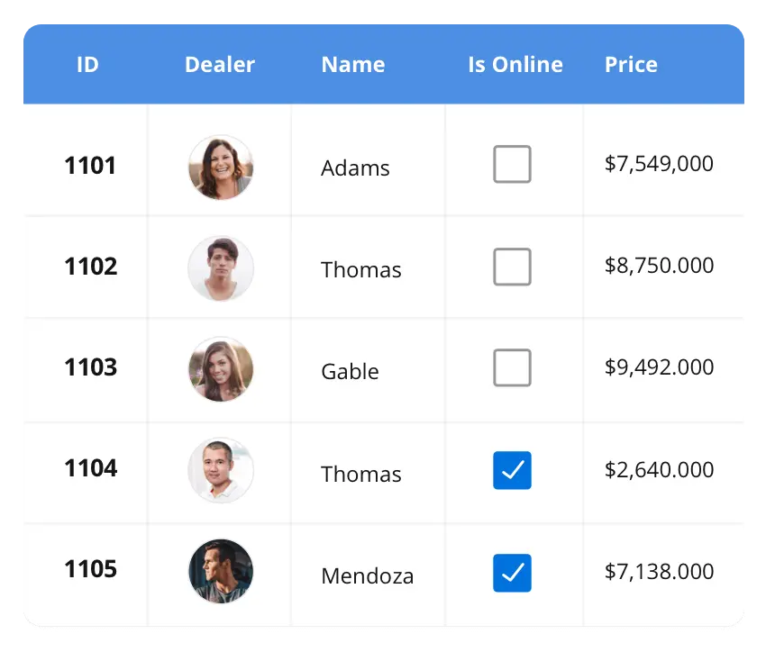


DataGrid
The DataGrid control is a high-performance grid component that helps display and manipulate large amounts of data in a tabular format. Its rich feature set includes functionalities like data binding, sorting, grouping, editing, filtering, swiping, dragging, resizing, loading more items, pull-to-refresh, and exporting to Excel and PDF file formats.
SUPPORTED PLATFORMS
JavaScript Angular React Vue Blazor
Flutter jQuery ASP.NET MVC ASP.NET Core
ASP.NET Web Forms
WinForms WPF WinUI Flutter Xamarin UWP
Xamarin Flutter UWP

Slide 4
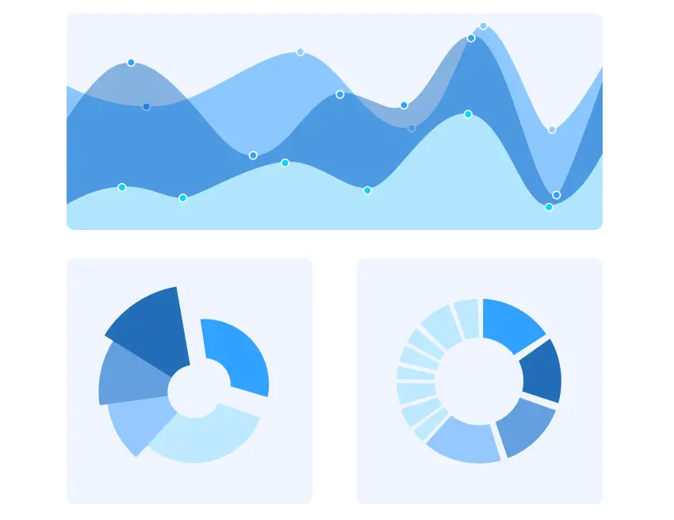
Charts
The Charts control can plot a wide range of chart types, ranging from lines charts to specialized financial charts. Its rich feature set includes functionalities like data binding, multiple axes, legends, animation, data labels, annotations, trackballs, tooltips, and zooming.
SUPPORTED PLATFORMS
JavaScript Angular React Vue Blazor
Flutter jQuery ASP.NET MVC ASP.NET Core
ASP.NET Web Forms
WinForms WPF WinUI Flutter Xamarin UWP
Xamarin Flutter UWP

Slide 5
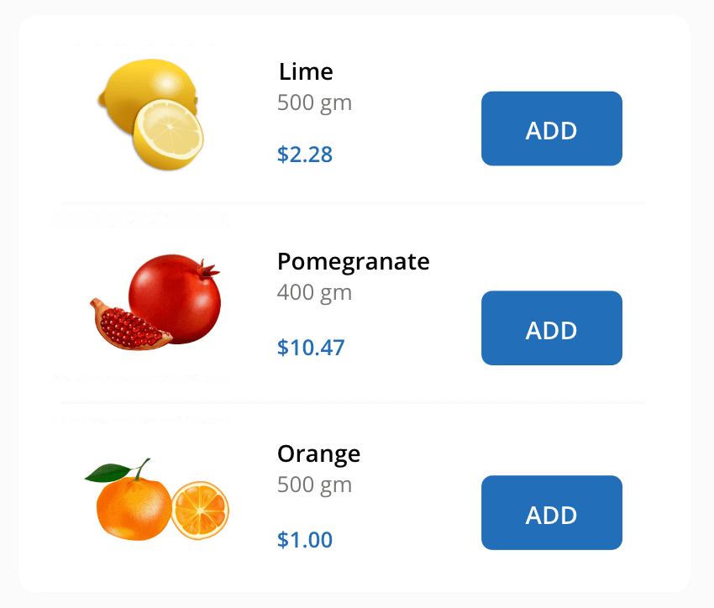
ListView
The ListView renders a set of data items with UI views or custom templates. It has many features like grouping, sorting, filtering, paging, swiping, multiple section, drag and drop, and different layout types. The ListView control has been optimized to work with large amounts of data
SUPPORTED PLATFORMS
JavaScript Angular React Vue Blazor jQuery ASP.NET MVC ASP.NET Core ASP.NET Web Forms
WinForms .NET MAUI Xamarin
.NET MAUI Xamarin

